Slide 1
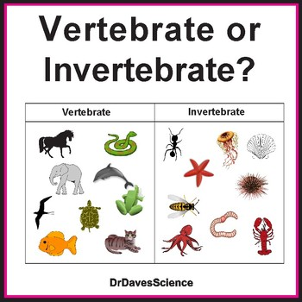
2022 Year 7 science classifications: vertebrates & invertebrates
By Miss Serafino

Slide 2
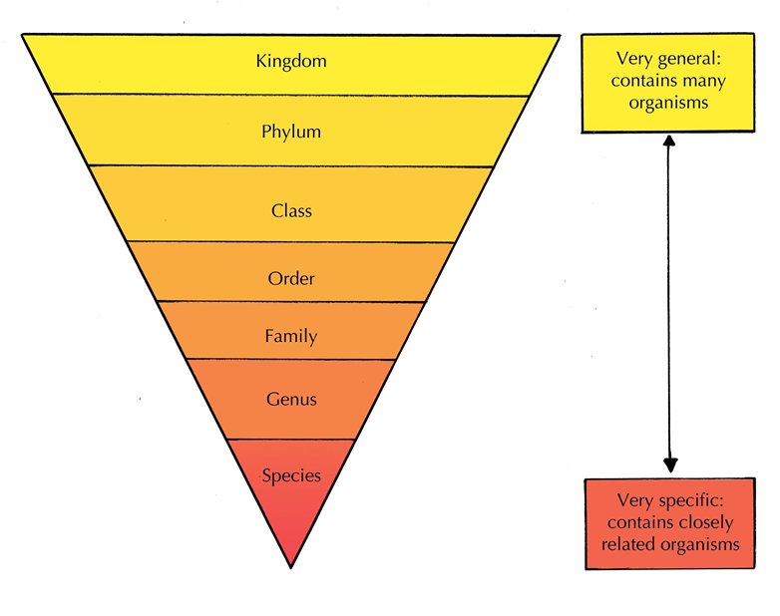
Recap previous learning
The Classification Hierarchy
“King Philip Crawled Over Four Gooey Snails”
Kingdom
Phylum
Class
Order
Family
Genus
Species

Slide 3
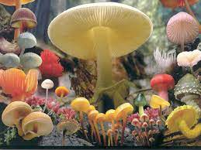

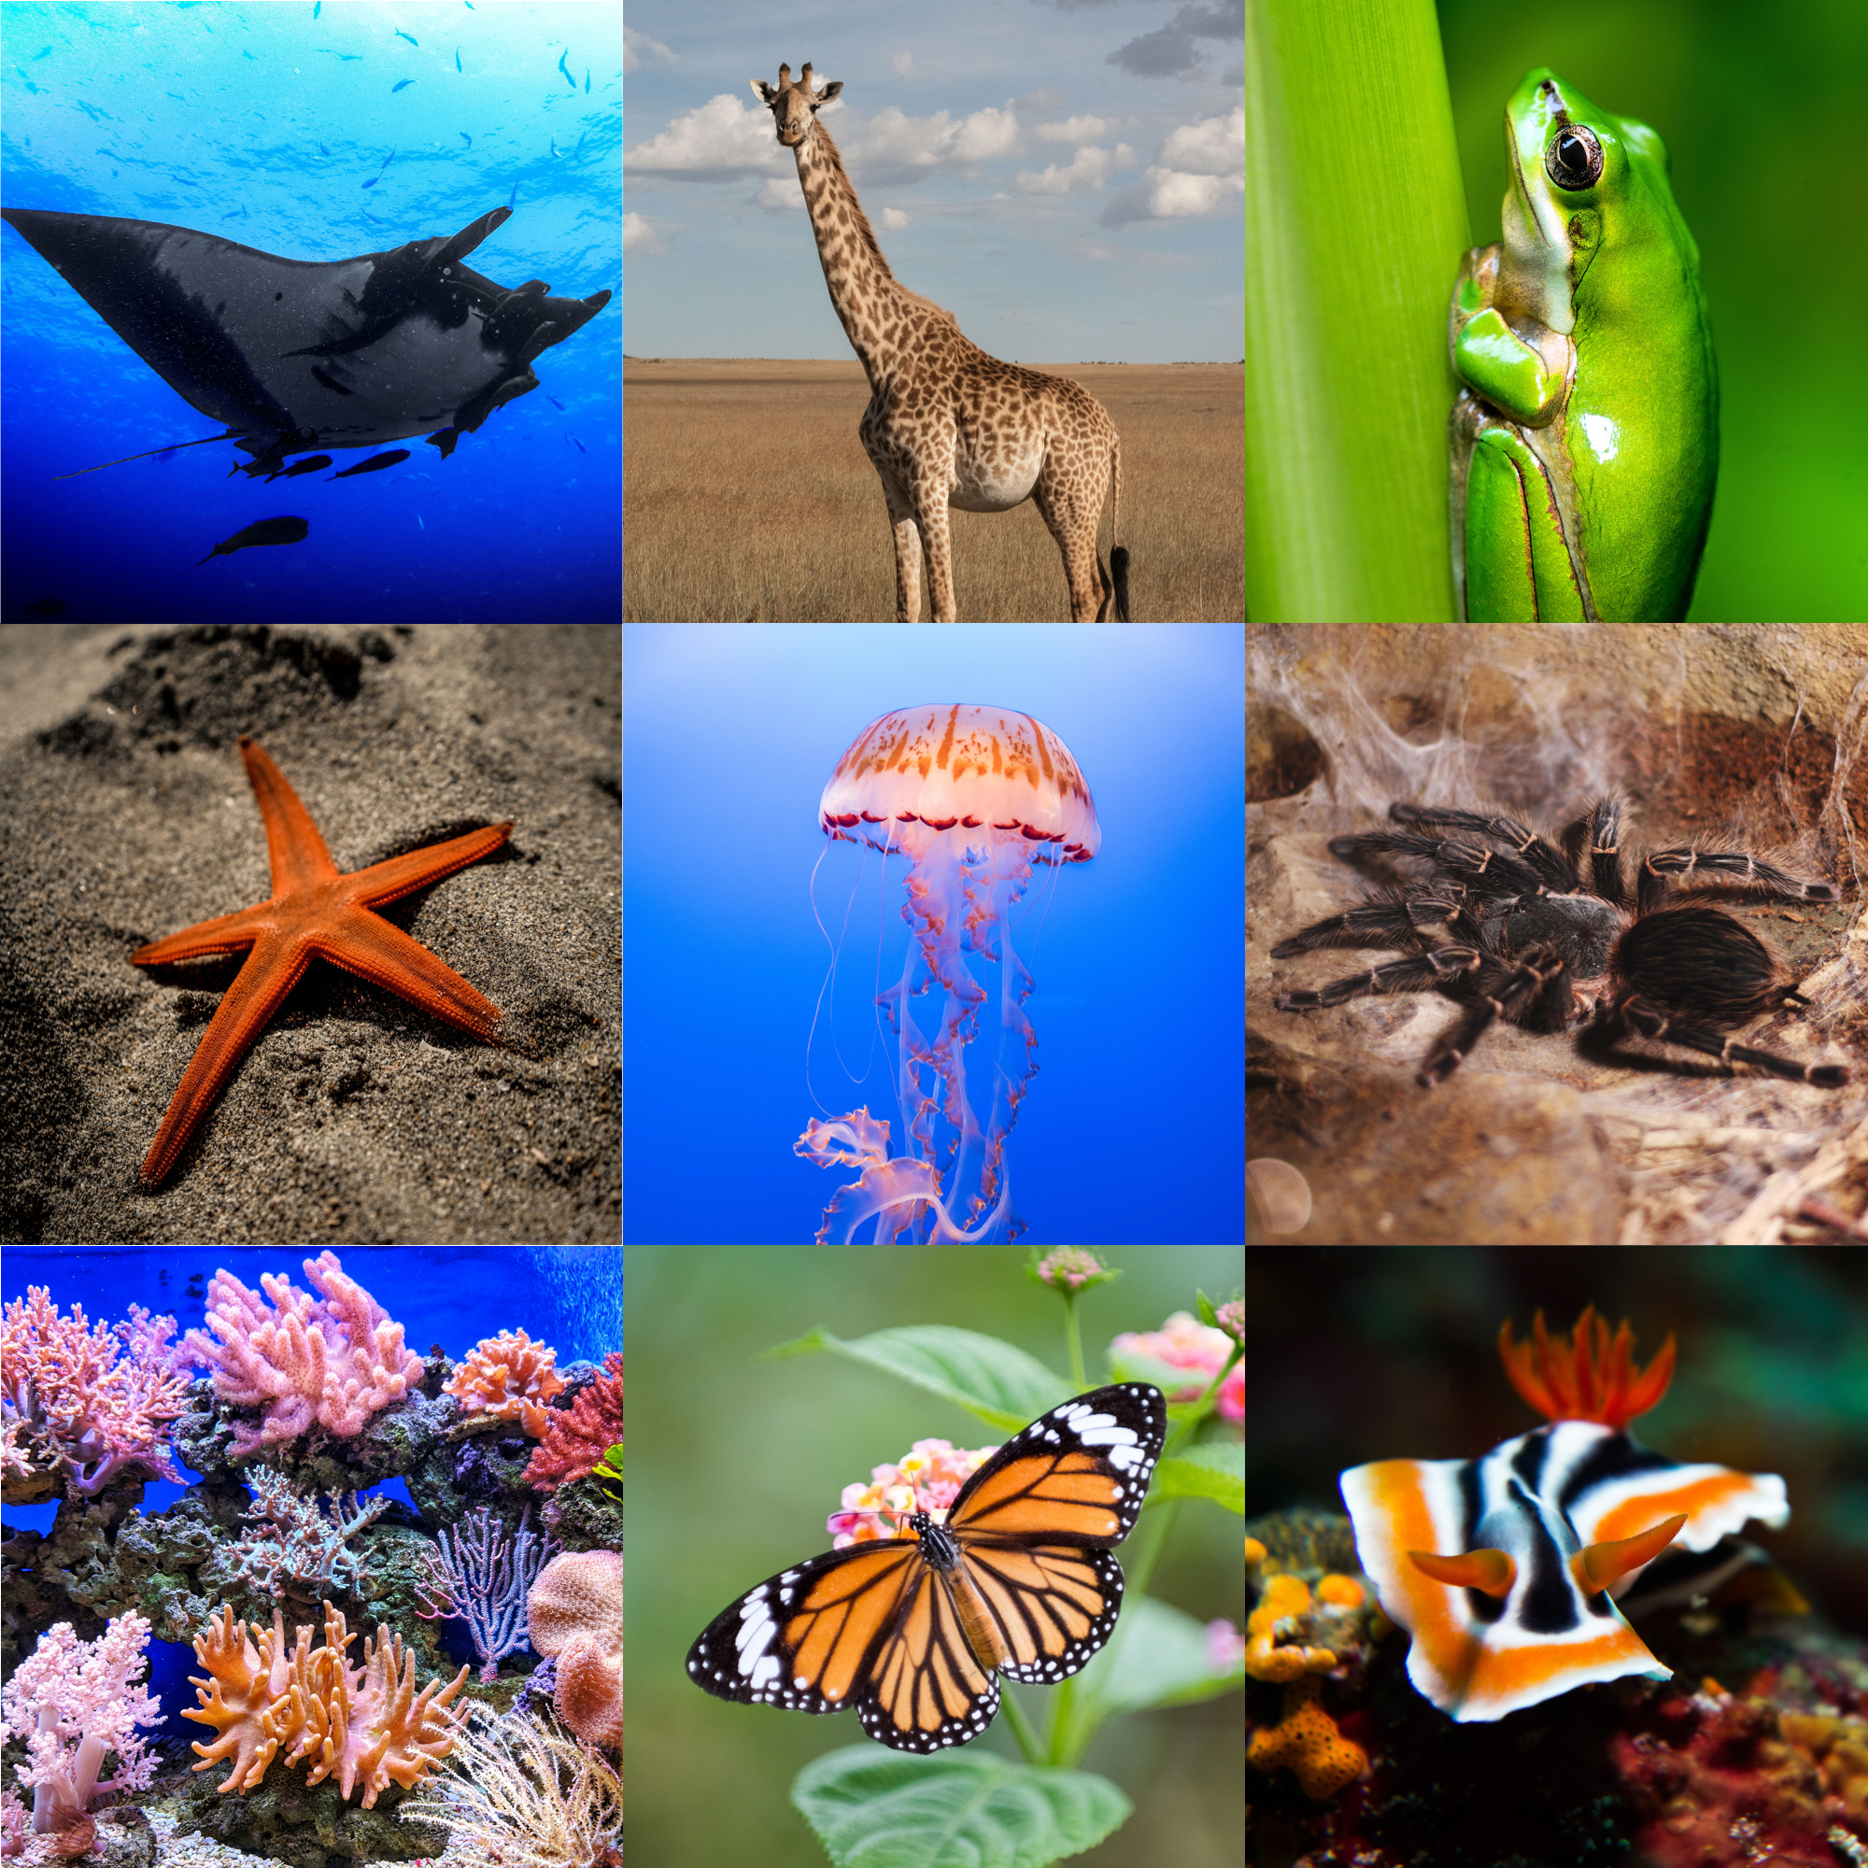
Recap previous learning
The 5 Kingdoms within the Classification Hierarchy
Fungi
All fungi are heterotrophs as they feed from the remains of dead animals and plants
Fungi can develop from tiny spores and grow in wood / soil
Examples include mushrooms, toadstools, yeasts, puffballs, moulds and truffles
Scientists that study this kingdom are Mycologists
Plantae
Organisms within this kingdom are multicellular and autotrophs
Organisms have a cell wall around the outside of the cell
Scientists that study this kingdom are Botanists
Animalia
Organisms within this kingdom are multicellular and heterotrophs
Organisms store their genetic material within the nucleus of their cells
Scientists that study this kingdom are Zoologists

Slide 4
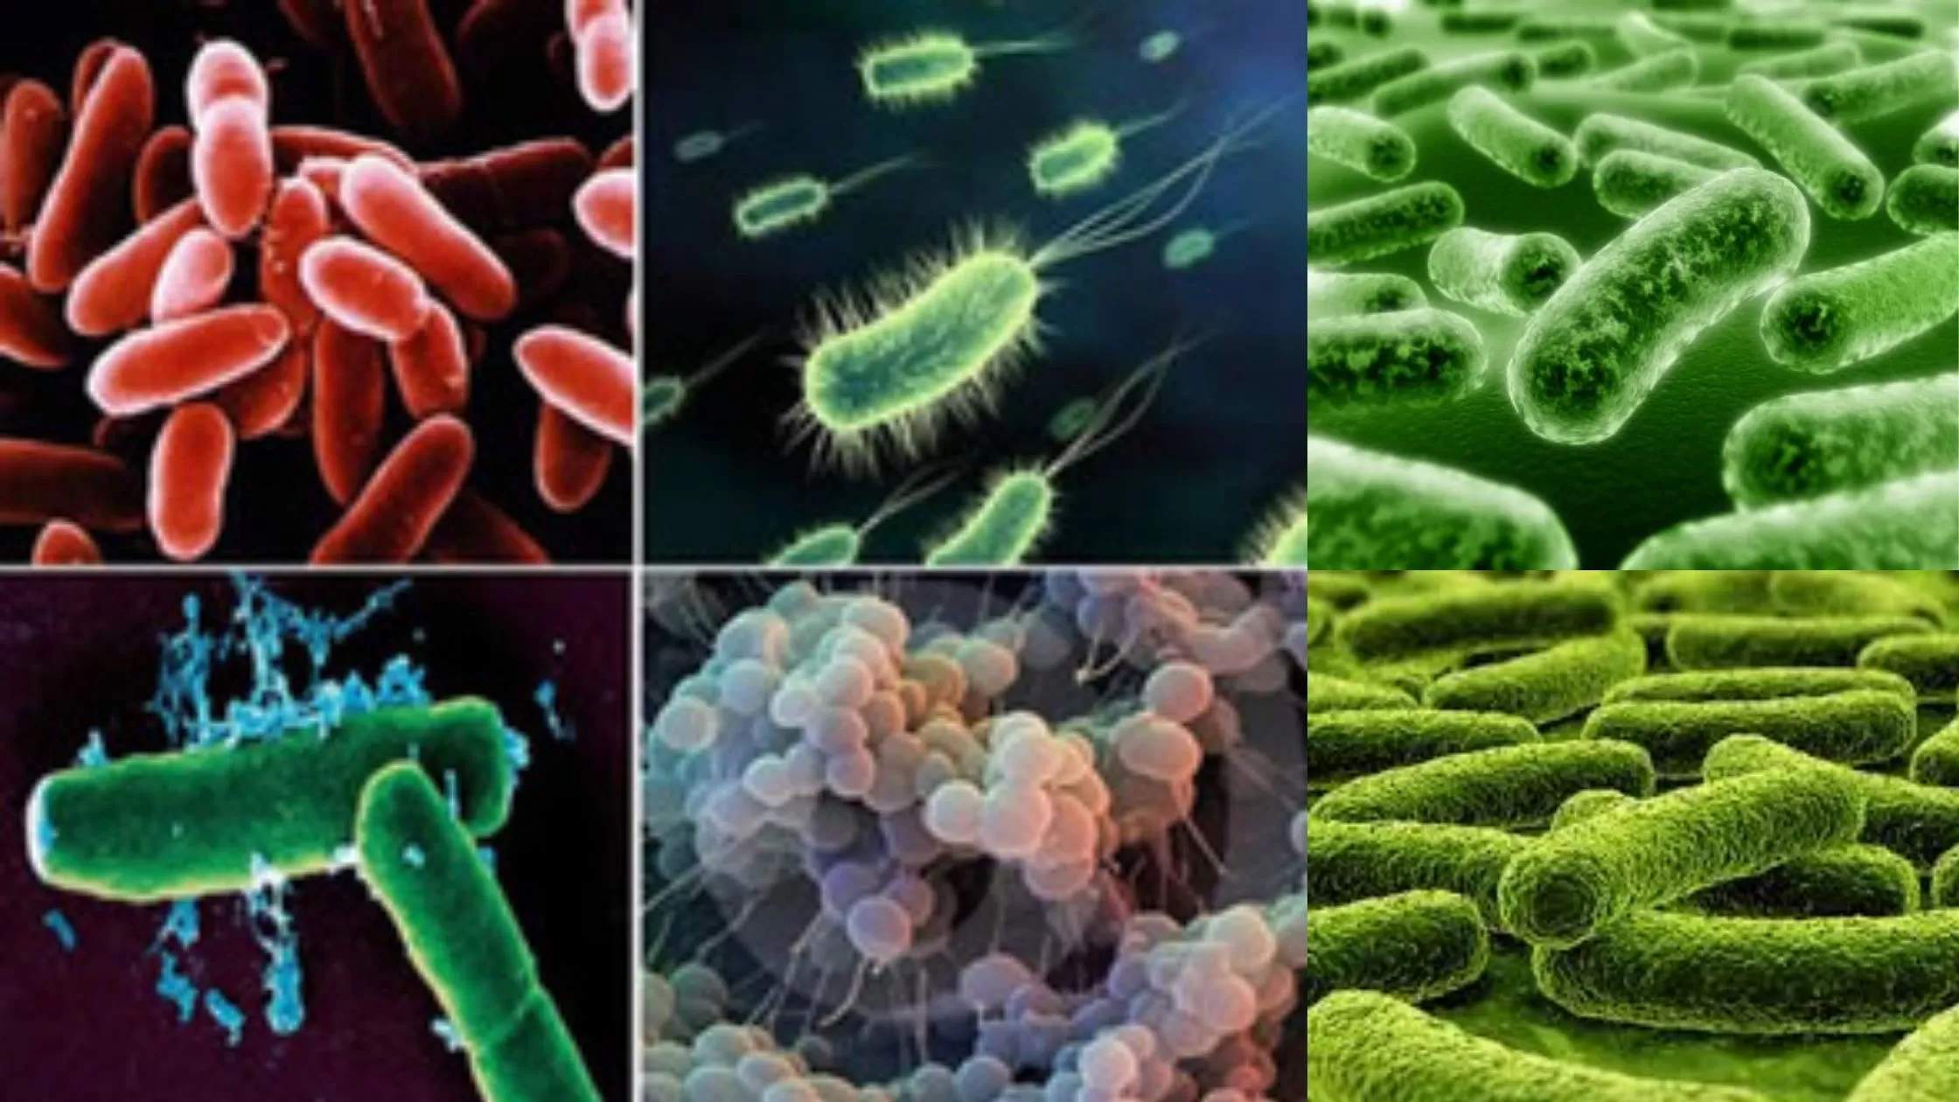
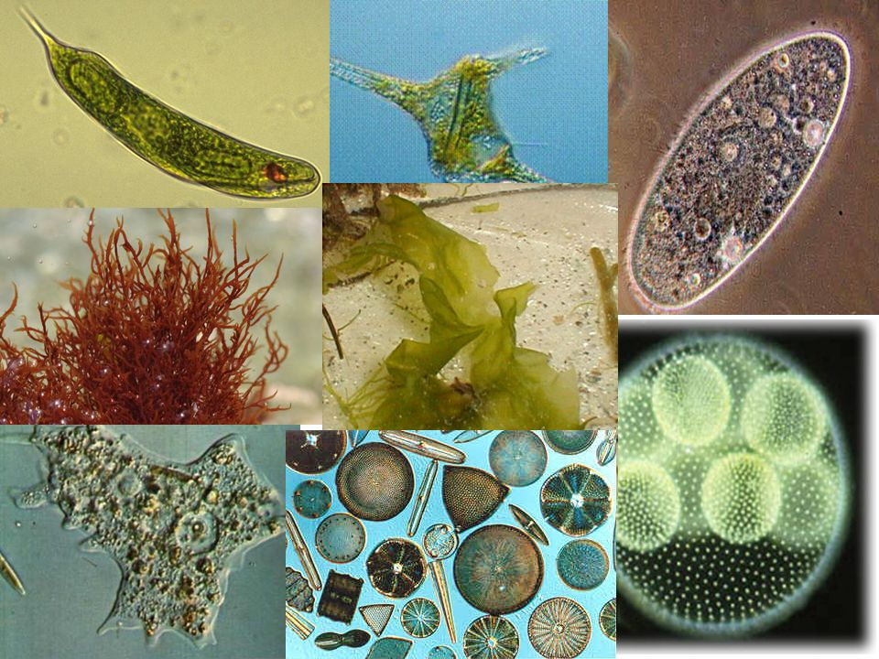
Recap previous learning
The 5 Kingdoms within the Classification Hierarchy
Monera
Organisms within this kingdom they are all unicellular and have a cell wall but no nucleus
Example includes bacteria
Protista
Organisms that do not fit into the other kingdoms will often belong in Protista
They range in size and are primarily unicellular organisms
Common feature is they store their genetic material inside a nucleus
→ Examples include plankton, amoeba, protozoa, simple algae, fungi, slime and moulds

Slide 5
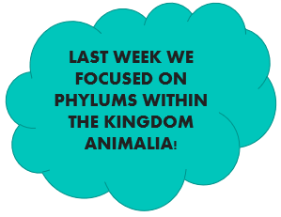
Recap previous learning
Characteristics of Kingdom Animalia
Multicellular
→ All animals in the kingdom Animalia are considered multicellular.
→ This means they consist of multiple cells, hence the name ‘multi’ cellular which store genetic material within a nucleus of these cells.
Heterotrophs
→ Animals are considered heterotrophs, which means they cannot produce their own food. This is because they gain energy via nutrition from other living things.
Motile & Non-Motile
→ Animals can be motile or non-motile. Motile means they are capable of movement on their own and non-motile means they are not capable of movement on their own.
Eukaryotes
→ Animals are considered eukaryotes, which means their cells have a nucleus that contains genetic material which is enclosed with a nuclear envelope.

Slide 6

Todays lesson
Learning Objectives
Distinguish between ‘Vertebrates’ and ‘Invertebrates’ within the Kingdom Animalia
Identify and describe the 5 classes of chordates
Pisces (Fish)
Amphibian
Reptilia
Aves (Birds)
Mammalia

Slide 7
Invertebrates
96% of all animals are invertebrates within the kingdom animalia
Invertebrates are animals which do not have a spinal cord or have an external skeleton (referred to as exoskeleton)
Examples include beetles, crabs, insects, squid and slugs
Invertebrates can be classified into 6 main phylum’s based on their characteristics
Poriferans: sea sponges with pores
Platyhelminths: soft, long and flattered bodies. E.g., flatworms
Molluscs: posses soft unsegmented body, with possible protective shell. E.g., snail
Arthropods: possess segmented body and/or have legs joined together. E.g., crab
Cnidarians: soft hollow body with tentacles. E.g., jellyfish and anemone
Echinoderms: rough/spiky skin & arms radiate from centre of body. E.g., starfish

Slide 8
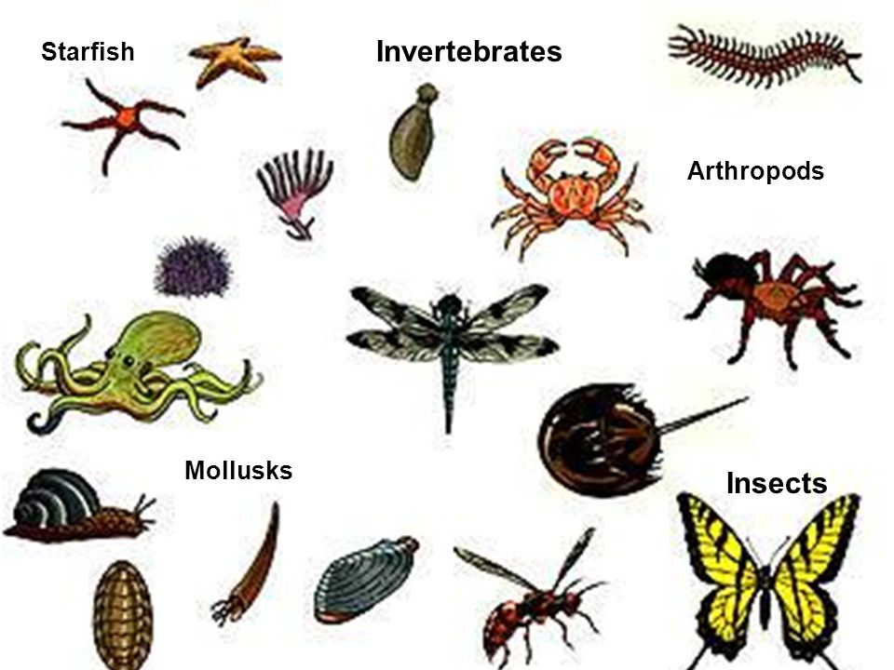
Invertebrates

Slide 9
Vertebrates
Vertebrates are within the Phylum ‘Chordata’ and Kingdom ‘Animalia’
Are animals with a spine, backbone or internal skeletal (referred to as endoskeleton)
→ Examples include cats, humans and birds
Vertebrates can be broken down into further subgroups called classes based on their body covering, how their young are born and their body temperatures
The 5 classes include: Pisces, Amphibian, Reptilia, Aves and Mammalia
Vertebrates either have a constant body temperature (referred to as endotherms) or a body temperature that changes with the environment (referred to as ectotherms)

Slide 10
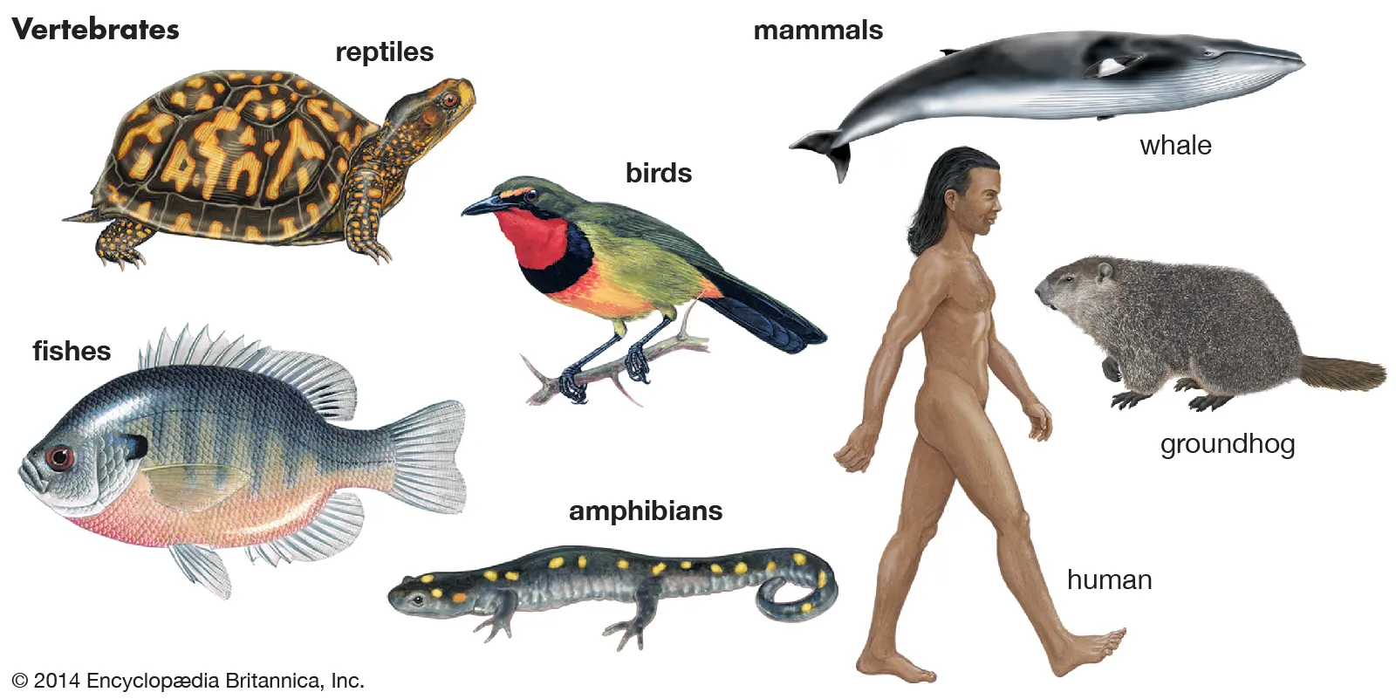
Vertebrates

Slide 11
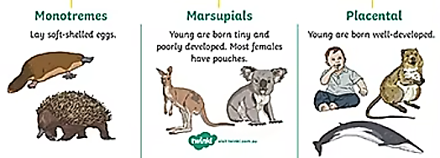
Vertebrates
Class Mammalia
Examples include humans, dogs, cats, rabbits, guinea pigs and mice
Mammals are animals with hair or fur and are endotherms (constant body temperature)
Female mammals give birth to live babies and feed their babies with their own milk
Class Mammalia can be further broken down into 3 subgroups which classify these animals in the common ways in which their babies develop:
Monotremes
Marsupials
Placentals

Slide 12
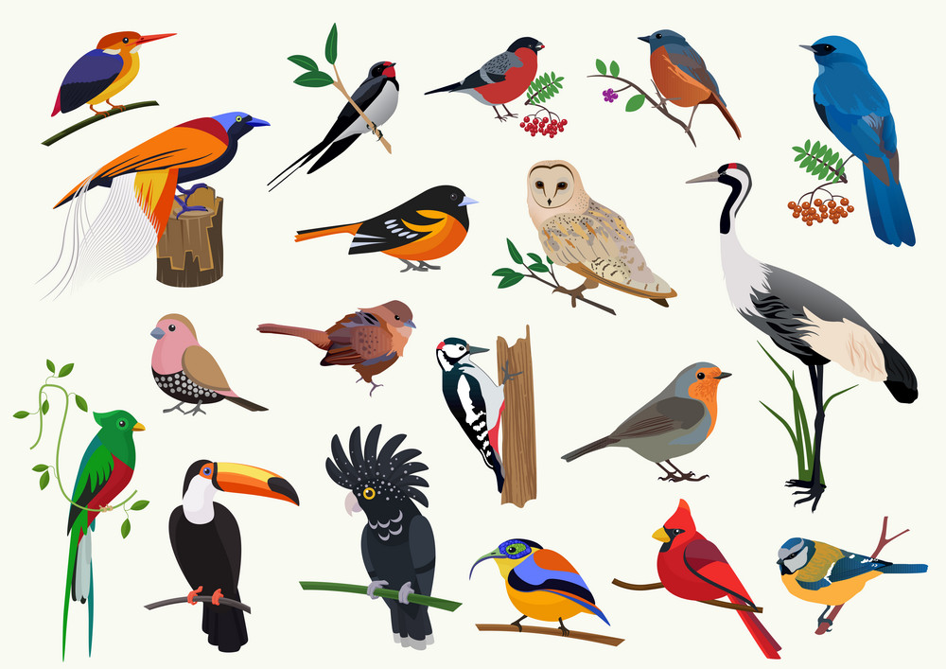
Vertebrates
Class Aves (Birds)
Example includes all type of birds
Aves are endotherms and their two main distinguishing characteristics (they way they look different) are their covering in features and their scaley legs
All Aves lay eggs with a hard shell

Slide 13
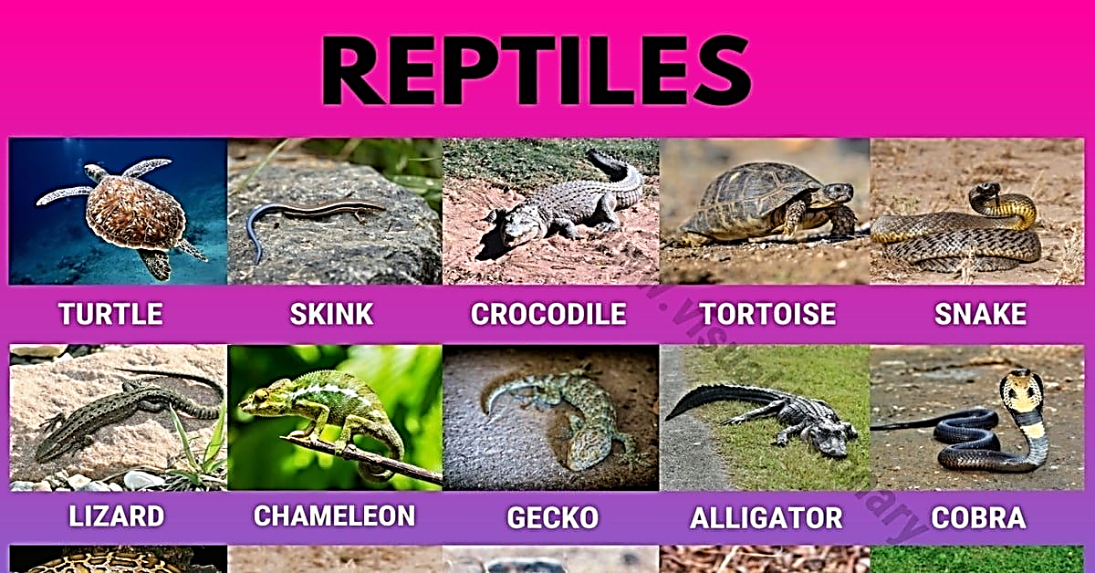
Vertebrates
Class Reptilia
Examples include snakes, lizards and turtles
The skin of reptiles are usually covered in fine scales
Reptiles are ectotherms and use lungs to breath even if they live under water (e.g., sea snakes)

Slide 14
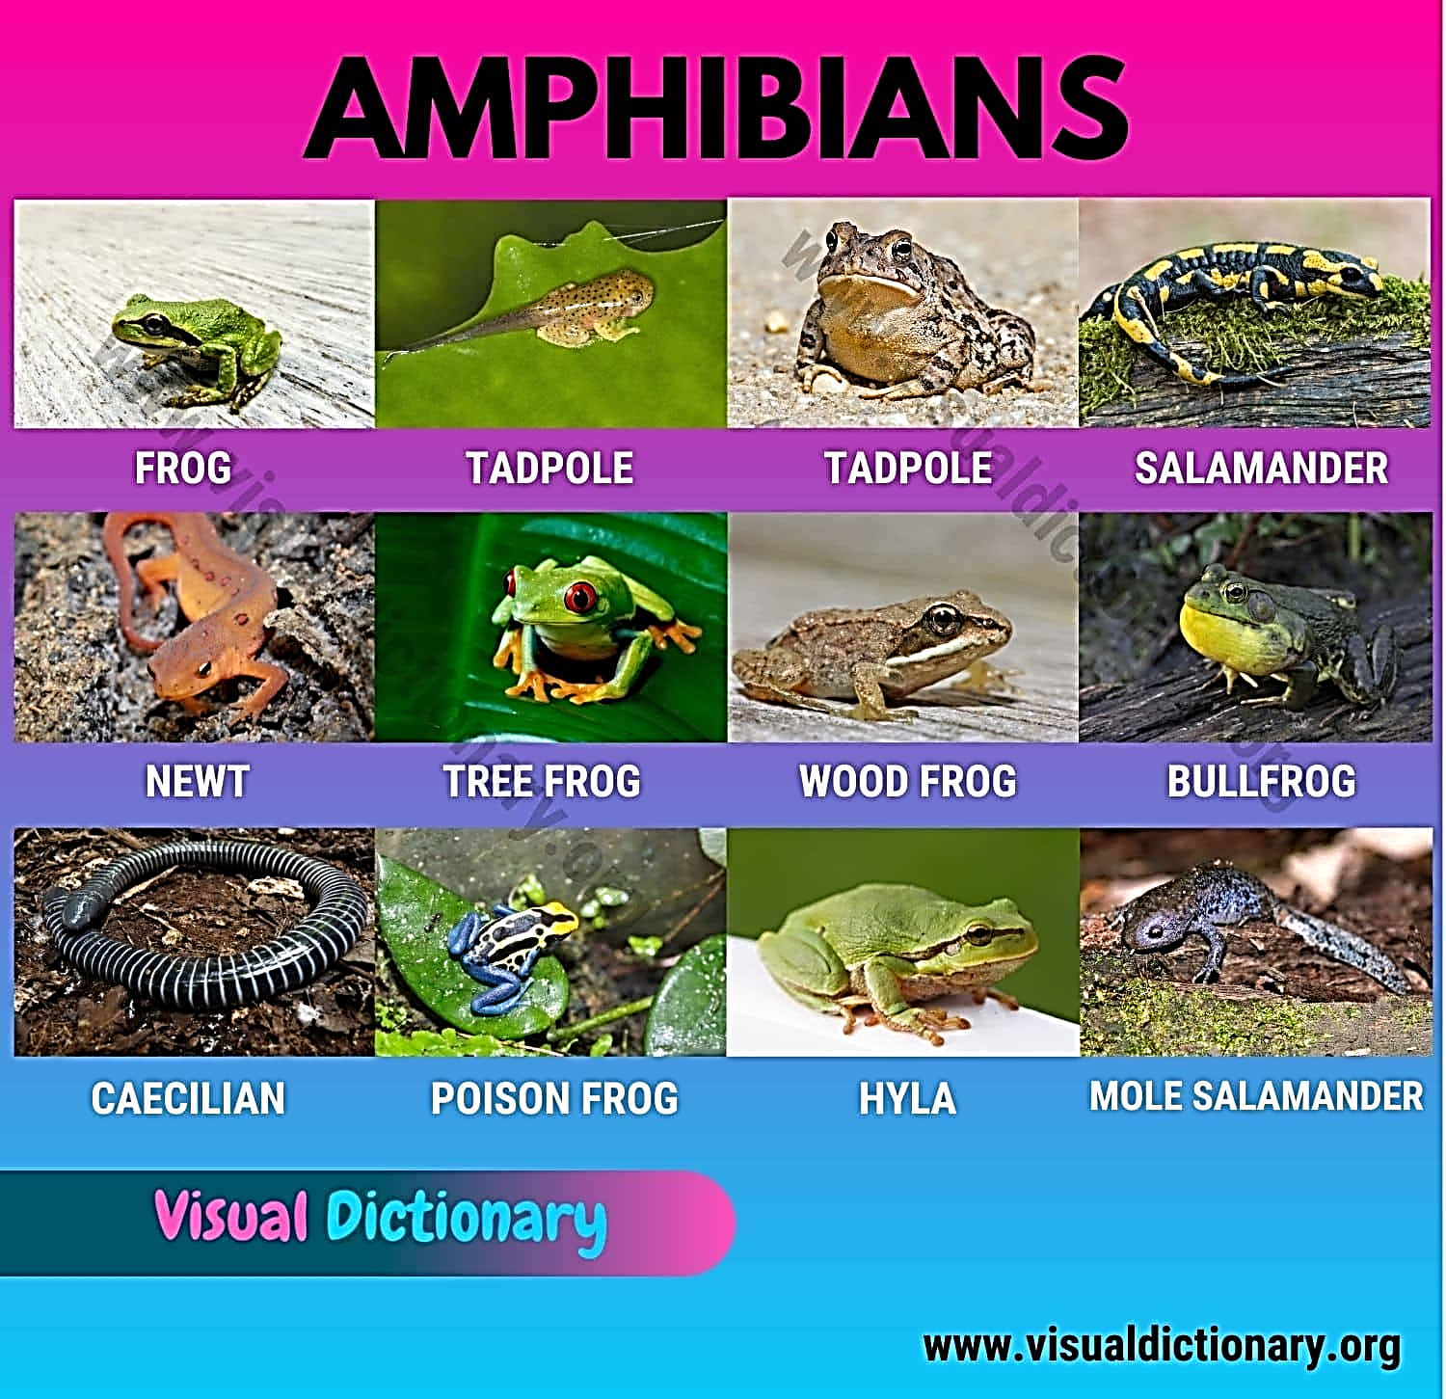
Vertebrates
Class Amphibia
Only remaining group of amphibians within Australia is frogs, in other parts of the world caecilians and salamanders may be found
Amphibians are ectotherms and their skin in usually soft and slimy
Amphibians lay their eggs without shells in water
For the first part of their life they have gills and live in the water and as they get older they develop lungs and become able to live on land

Slide 15
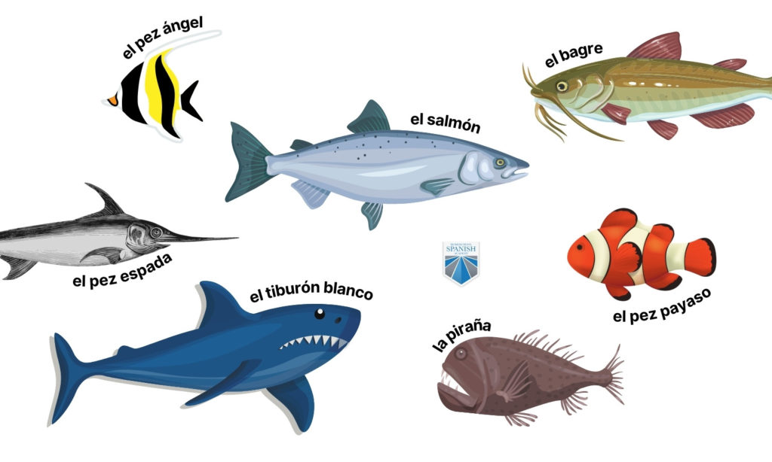
Vertebrates
Class Pisces (Fish)
Examples includes all types of fish
Most Pisces are ectotherms and are covered in a layer of scales and most have fins
Pisces spend all their life in water and therefore need gills to breathe
Pisces are further grouped into smaller groups according to their skeleton
Sharks, rays and skates have a skeleton made entirely of cartilage whereas other fish have bony skeletons

